Slide 1
Making Today’s Internet Faster
(Automatic Transition To Peer-to-Peer Download)
Notes:
Making P2P more adoptable.
More usable.
Useful in more situations.

Slide 2
Thanks!
Family
Teachers
wE\=f P'P= \ROVIDE A U966554F545DS6TFDV87654536:01 PM 4/5/20102 098YH6Ya 1W N.I
Notes:
This is you
TODO: new pic

Slide 3
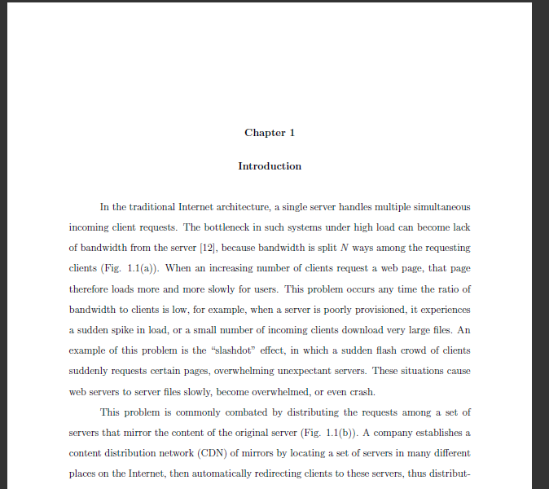
Thesis

Slide 4
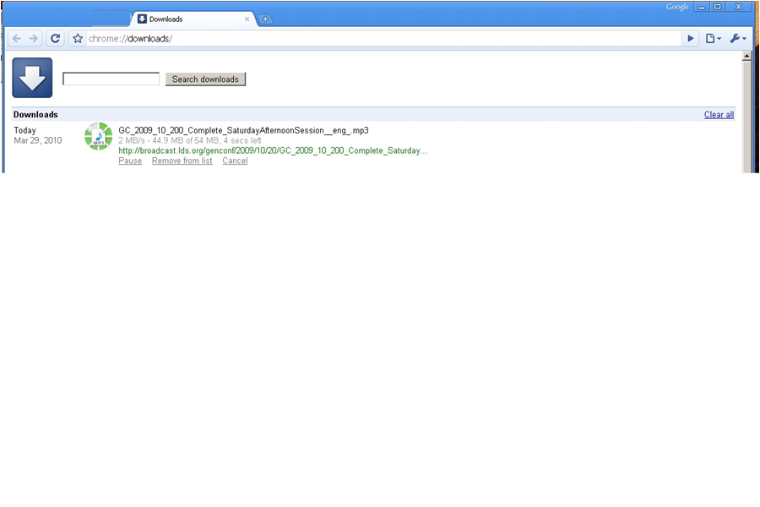
Fast download

Slide 5

Slow downloads
Frustration
Wasted bandwidth
Notes:
Today's Internet is sometimes slow. It is.
This is very frustrating to today's work flow, and annoying.
"today's bottleneck is no longer the disk or cpu--it's the network!"
"all this wasted bandwidth“
Lodo:
Add a graph of network speed increasing so slowly compared to processors [?]

Slide 6
User options
Hit reload.
Try somewhere else.
Download Manager.
Add a local proxy.
Beg the server to change how they serve the file.
Notes:
Download manager—for me speeds things up, but hard to use because not integrated, also the server might run out of bandwidth.
Adding a local proxy doesn’t help if the file hasn’t been downloaded locally already—same exact problem in many cases.
“Go and do something else”
“Go and read your email”

Slide 7

Server options
Buy more bandwidth.
Move.
Buy more servers/rent a CDN
Popular
Flash flood.
Notes:
TODO add CDN pic

Slide 8

CDN fails

Slide 9

Turn to P2P
Create BitTorrent File.
Host it, create tracker.
Peers download and share blocks.
Works well for large popular files.
Notes:
“Melissa style” explanation (you download half, your friend downloads half, you share halfs).
You don’t need any extra servers, peers do most of the extra hosting.
Bram: “When I created BitTorrent in 2001, my mission was to solve the problem every website has when distributing large, popular files”

Slide 10
BitTorrent fails
Server side.
Per File
Have to provide traditional anyway.
Lack of clients.
Stigma.
Extra maintenance.
Fast enough
Notes:
Unknown value to the administrator—its typical value is for large popular files, so if you don’t have any of those, it’s not worth it.
Because of these barriers, few servers are setup to use BitTorrent, and many users ignore them even when they are, because of unreliable results.

Slide 11
BitTorrent fails
Clients
Extra setup/time per file.
Small files
Techno intelligencia
Non integrated.
Manual.
Not HTTP optimized.
It should be ignored speed-wise
Duplicate
Costs time
Not available.
Notes:
It would be annoying for small files because it is so manual.
2) When a user runs into this, it typically takes extra time in order to download this way, because you have to go through some extra steps, like downloading the .torrent file, then waiting some time for your client to contact the tracker, get peer lists, find peers that are willing to share with you, etc.
It would be painful to have to do this for many small files, like browsing a web page. Up to 10 files for byu's web site. Even if they *did* a BitTorrent file for each of these small files, today’s systems include a manual step in order to download each file. Modern browsers don’t handle inline p2p. So P2P basically can’t be used for a typical web page.
How many sites actually offer you that stuff?
Normal people do not use BitTorrent. Not useful to them.

Slide 12
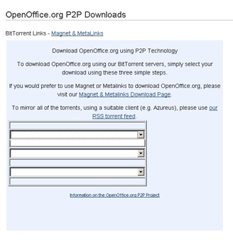
BitTorrent can Fail
Not enough seeds.
Closed ports.
Tracker
Extra files.
Users don’t have client installed.
Clients aren’t configured to use HTTP.

Slide 13
Automatic Swarming -- Goals
Work for any file on any server.
Easy on the clients.
No extra dedicated hardware.
Work for small files.
Non intrusive.
Notes:
Automatic Swarming, which aims to alleviate these problems.
All areas where BT falls short.
Also: only go to P2P when necessary (try to be as fast as normal download).

Slide 14
Automatic Swarming
Basic Algorithm:
Monitor download
Automatically switch to a Peer-to-Peer download if it becomes slow.

Slide 15
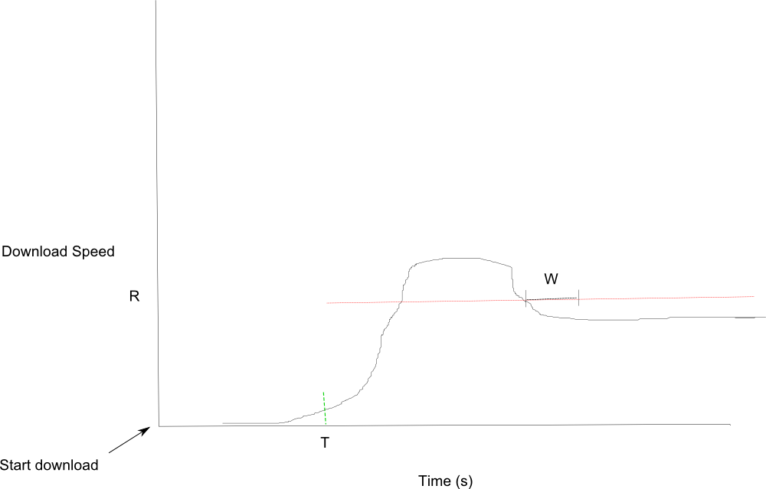
Monitor Download

Slide 16
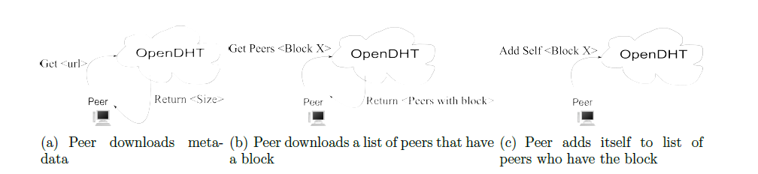
Find Peers, share
Notes:
No more depth needed, uh guess.

Slide 17
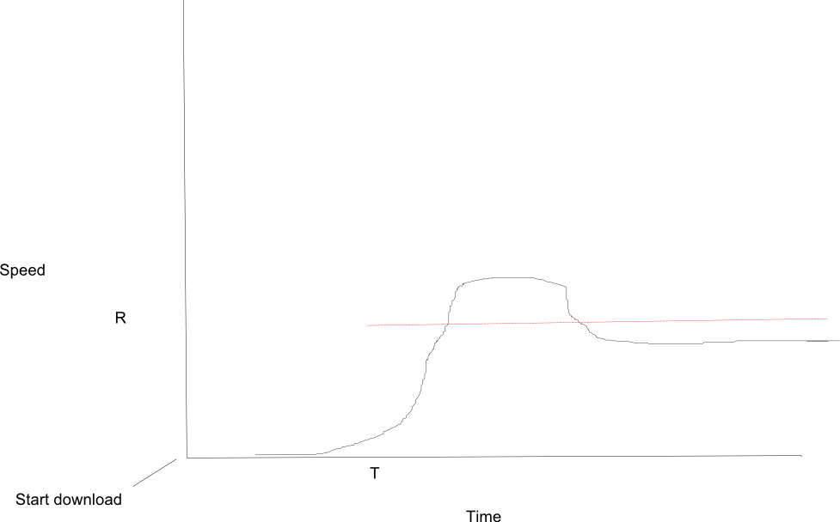
Details
T starts immediately.
R is calculated W seconds after T
Redundant DHT keys.
Polls on lack of peers (1s)
Downloads block from origin
Last block problem
Notes:
Add descr. picture here?

Slide 18
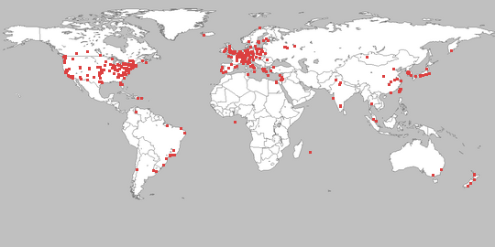
Methodology.
PlanetLab
Private OpenDHT
BYU server
256 KB/s

Slide 19
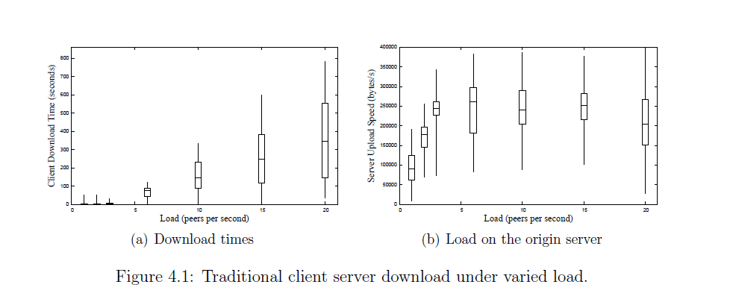
Performance Client-Server

Slide 20
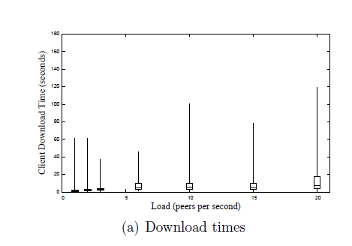
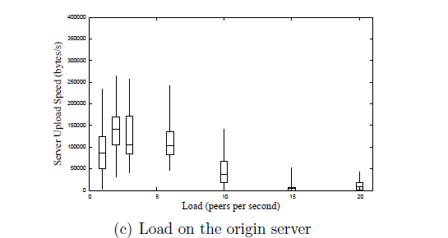
Performance – Automatic Swarming

Slide 21
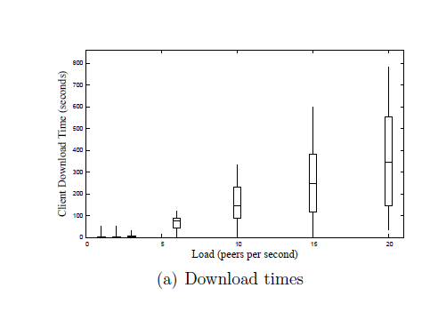
Comparison
Notes:
This is no comparison. Show once I have a real graph.

Slide 22
Effect of Varying Parameters
T, R, W
Multiple Files
Large Files
Block Size
Linger Time
Peer count
Notes:
Say what type of loads we’re going to use (et al).

Slide 23
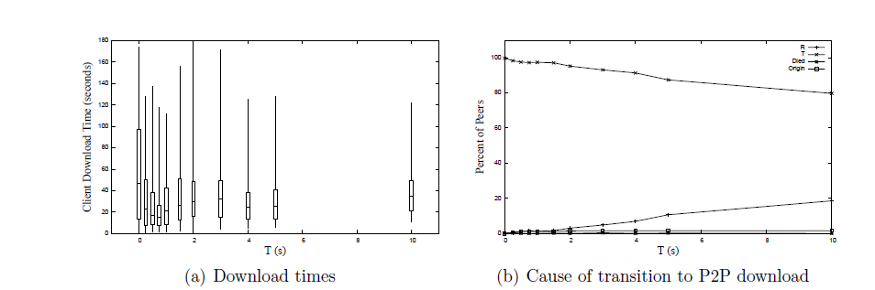
Varying T

Slide 24
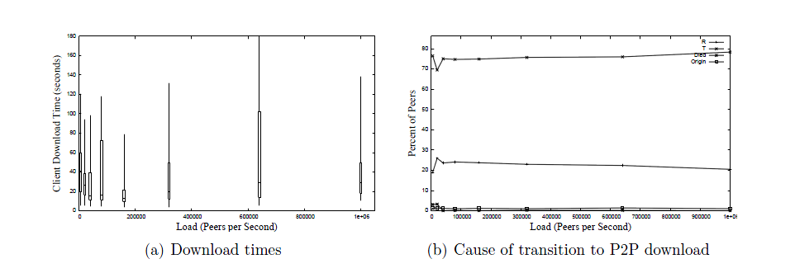
Varying R
Notes:
Please another graph here. Please?

Slide 25
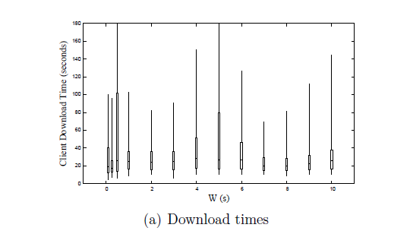
Varying W
Notes:
Not much change, really. Because it only affected at most the first few, because after that the server became saturated and T would always fire first.

Slide 26
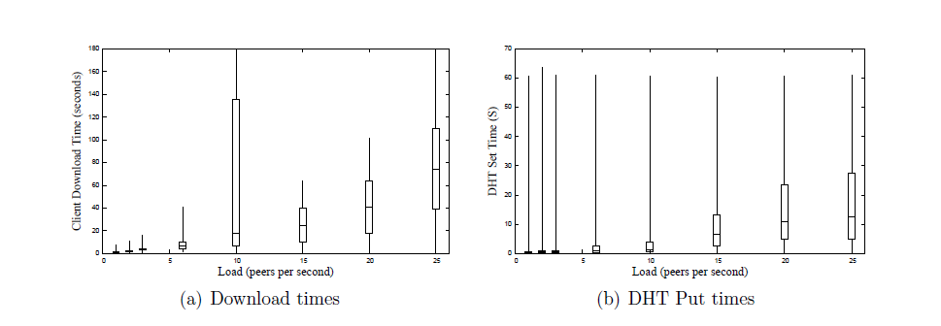
Full web Page
Notes:
Note that our linger time was 20 seconds, so the DHT was becoming less effective under higher load.

Slide 27
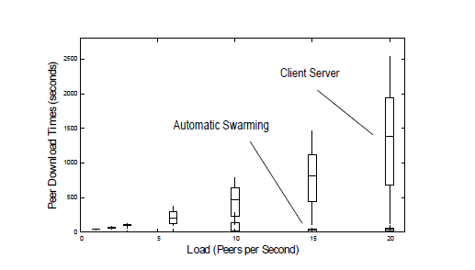
Versus Client-Server

Slide 28
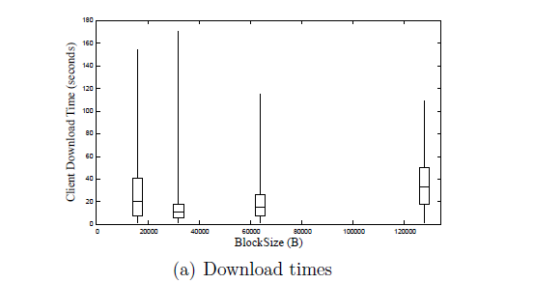
Block Size
Notes:
Fastest was 32 KB, presumably because I download from the last few peers in parallel, so this fits best.

Slide 29
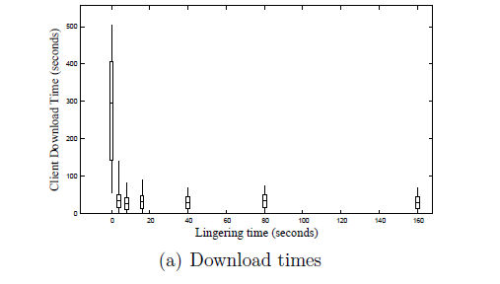
Linger Time

Slide 30
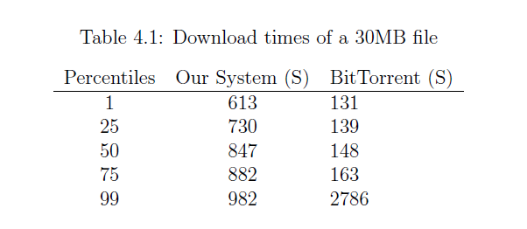
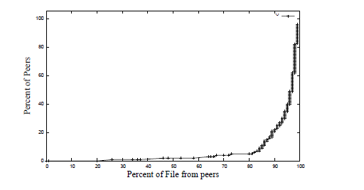
With Large Files
Notes:
“Ours doesn’t perform as well as BT for large files.”
You can see that at about 730 to 882 seconds most of our peers finish the file, and most of the peers download it from peers, so once we get the file out there we work all right, but we could do some work still to increase our speed of propagating the blocks.”

Slide 31
Conclusion
Viable.
30 x as fast for small files
Notes:
"real" use is probably currently [who knows for sure] "most useful in the wild" for larger static files, still.
Kind of an auto-BitTorrent for all files on the Internet, though we have shown it can work well for small files, too, so something like this could become
A real contribution to browsing the Internet.
Demo?

Slide 32
Automatic Swarming Benefits
Automatic transition
Small files
Client-server plus P2P
Client-side protocol
Notes:
" [cross each one out in turn] -- ours is a purely client-side modification, so servers don’t have to be set up with extra configuration
To participate, nor even opt-in ... [3]
Ours provides an automatic transition to P2P, so even with small files it can switch automatically, which makes it more user-friendly [no manual intervention required] [2].
Ours uses standard client-server until this is deemed slow, so it "knows" when P2P will be faster, thus alleviating the user from having to choose whether to ignore it or not [1].

Slide 33
Future Work
Back off the origin.
Validate Integrity.
Differentiate better for static/non-static.
Better use of the DHT (fairness, speed).
Dynamic parameters.
Incentives.
Privacy.

